Slide 1

Competitive Programming From Problem 2 Solution in O(1)
P
T
H
I
N
K
F
A
S
T
S
C++: 1D Arrays
Mostafa Saad Ibrahim
PhD Student @ Simon Fraser University

Slide 2
How many variables represented?
int emp1_id = 153;
Automic variable: This points to SINGLE value
string emp1_name = “mostafa saad”
Again, variable points out to SINGLE person
But, How to represent a company with 10,000 employees?
Hmm...10,000 variables in code?
What if we want to add 1 more employee?

Slide 3
Arrays
List of elements of SAME type
E.g. List of integers, represents Ids
E.g. List of strings, represents names
Each list has size (e.g. 10000)
This list is 1 variable, has 1 name
We call it array
1D array: list of elements (mathmeatically vector)
2D array: represents a matrix (rows x cols)
Arrays: static / dynamic

Slide 4
1D and 2D arrays
Let’s represent 5 numbers to mean our heights:
1D array (vector)
170, 165, 186, 160, 177
int heights [5] = {170, 165, 186, 160, 177};
Let’s represent profit of 5 years cross 12 months
Mathematically, we need 5x12 matrix
Each row represent year,,,column represent month
int profitPerMonth[5][12];
Next Session...2D array

Slide 5
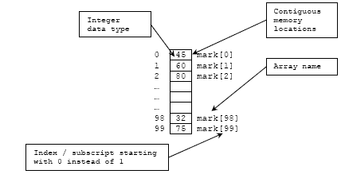
Visually
int mark[100] = {45, 60, 80, ....., 32, 75}
Src: http://www.tenouk.com/Module7_files/cplusarray001.png

Slide 6
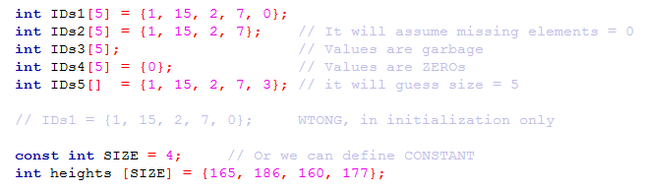
Declaration Examples

Slide 7
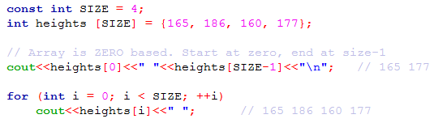
Displaying Elements

Slide 8

Reading Elements

Slide 9
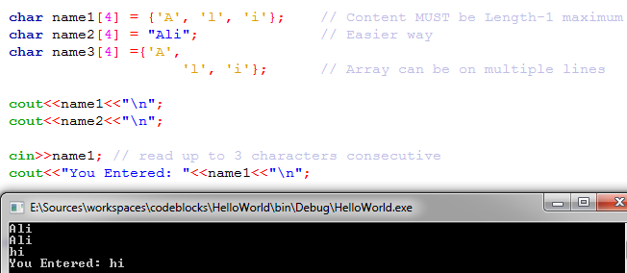
Char array

Slide 10
The null character
A null character is a byte which has all its bits set to 0.
Its value = '\0‘
Purpose: Mark char array end
If you define char arr[5], one char is null, that is why use MAXIMUM of 4 chars

Slide 11
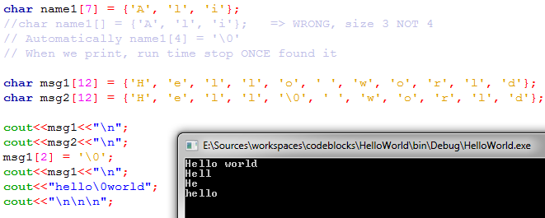
The null character

Slide 12
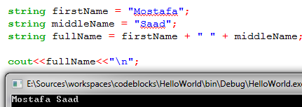
Remmeber the String
Remeber...we used something for strings before.
This is something called class...later we will know it

Slide 13
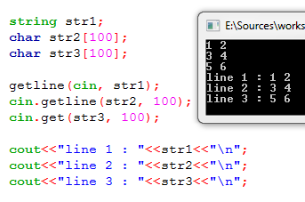
Reading a line of chars

Slide 14
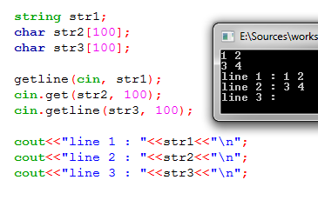
Reading a line of chars

Slide 15
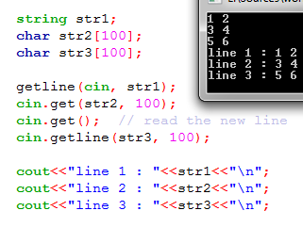
Reading a line of chars

Slide 16
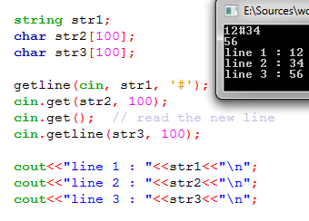
Reading a line of chars: Delimeter

Slide 17
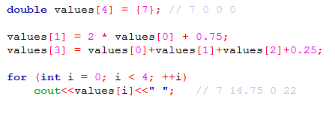
Playing...

Slide 18
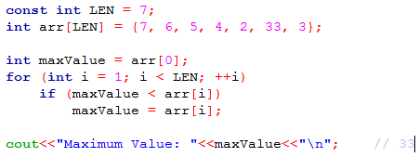
Get Maximum Value in array

Slide 19
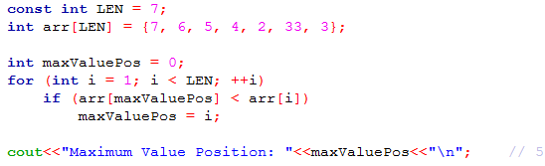
Position with Max Value?

Slide 20
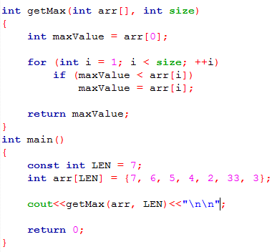
Array as argument: by reference

Slide 21
Memory storage
If we have array of Z elements
Then allocated memory Z x Size of (element)
int arr[5];
Memory: 5 x 4 bytes = 20 bytes
string names[2] = {“ali”, “sayed”};
In this case, sum memory of each element:
4 (ali) + 5 (sayed) = 9 bytes
In general, the total allocated memory

Slide 22
تم بحمد الله
علمكم الله ما ينفعكم
ونفعكم بما تعلمتم
وزادكم علماً

